Slide 1
Review Slides | : | Hand-over → Delivery
Prospect / Customer | : | Client Name
Opportunity Id | : | 13005936
Opportunity Description | : | Project Name
Document Date | : | 11th November 2024

Slide 2
Agenda
1 | Proposal Overview
2 | Proposal Sign-off Status
3 | Project scope, Timeline & Milestones
4 | Top 5 - Risks, Assumptions, Issues & Dependencies
5 | Hand-Over Status Proposal to Delivery Team

Slide 3
Proposal Overview

Slide 4
Proposal Overview - One pager
Proposal One Pager
Slide to be filled and presented in all Reviews leading to handover (or Win/Loss).
Keep this slide updated for each review, highlighting new changes each time.
Right-Click on the table and use “Object Worksheet / Open” to provide the requested info in all cells.
List of values and/or Online hints (helps) are available in the sheet itself.
You can also Double-click on the table and provide the requested info in all cells.
Most of the data must be completed with Freshsales Opportunity’s information
Do not change format of this slide.

Slide 5
Proposal Sign-off Status

Slide 6
Proposal Sign-Off Status
Proposal Sign-off
Slide to be filled and presented in Handover Review.
Keep this slide updated for each review, highlighting new changes each time.
Report the status of the sign-off, attaching all relevant artefacts.
Sign-off status to be confirmed in all reviews.
Sign-off for Delivery Commitment (Green is mandatory), Finance, Legal and Risk are mandatory. Other only when applicable.
Sign-off comments and clear decision request are mandatory if the RAG is either Amber or RED
Do not change format of this slide.
Duplicate slide if needed.
Area | RAG | Date & Approver Name | Role | Decision | Attach Artefacts
Delivery | R | DD-MM-YYYY – [Name] | [Role] | Scope:- Solutions:- Timeline:- Budget:- Margin:- Risk:- | [Artefact]
Finance/Contract |  | DD-MM-YYYY – [Name] | [Role] | Commercial : - Margin :- Cash Flow:- Contractual Terms:- | [Artefact]
Practice/CoE |  | DD-MM-YYYY – [Name] | [Role] | Technical Solution: Skills:- Accelalters:- | [Artefact]

Slide 7
Project scope, Timeline & Milestones

Slide 8
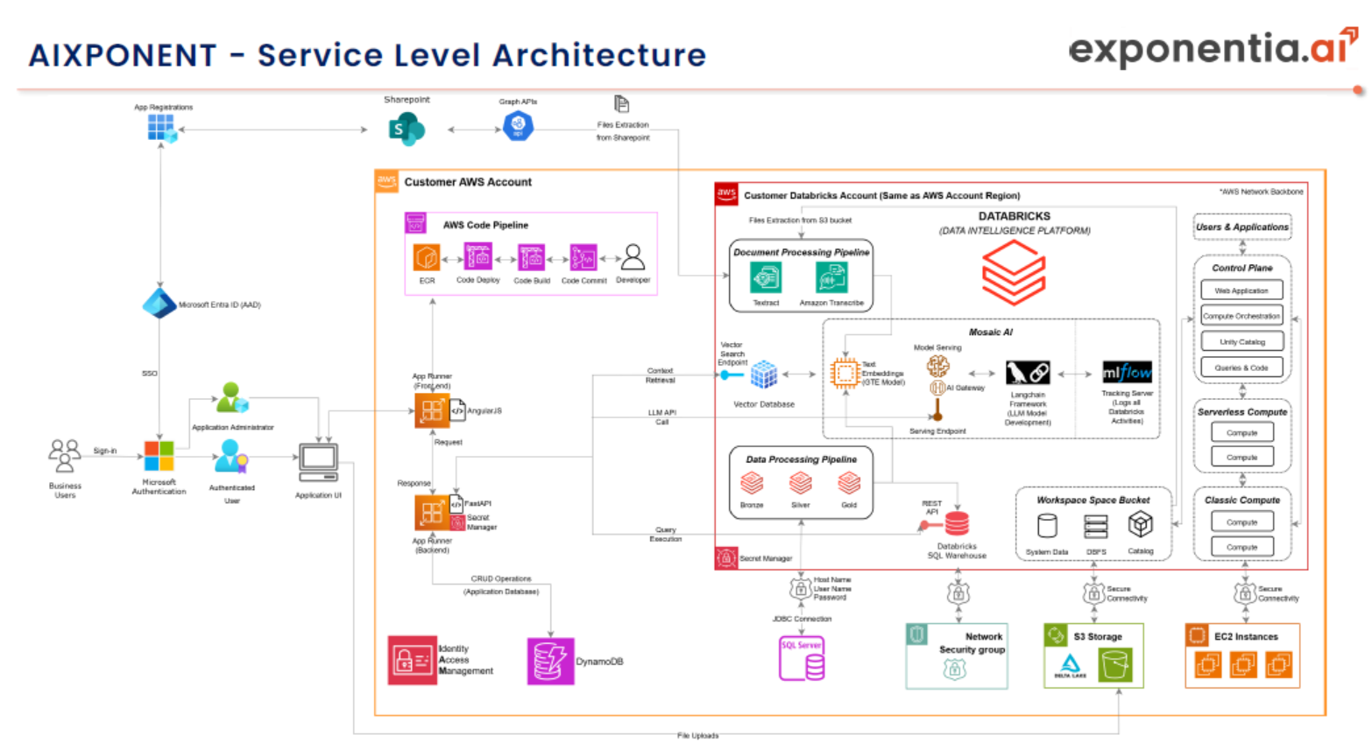
Project Scope
Nuvama Private plans to integrate GenAI capabilities into its platform for Relationship Managers, particularly those serving high-net-worth individuals (HNI), with the goal of enhancing customer experience, efficiency, and the productivity of the front-line teams
Exponentia is proposing the Gen AI accelerator, AIXponent, to assist Nuvama Private in addressing both their current business challenges and setting up a platform to address future use cases –
Unstructured Data Analysis
Portfolio Summarization (Structured Data Analysis)
Requirement
The aim is to Develop a Generative solution to assist Nuvama Private's Relationship Managers for HNI
The primary objective is enhancing productivity by reducing time spent searching for information and accelerating time to insights
The Gen AI solution will use natural language processing (NLP) to provide relevant and contextually accurate responses to user queries
The solution will be able to retrieve processed information from various data sources and formats
The solution enable faster and more informed decision-making by delivering concise and precise answers to improve the productivity of Relationship Managers
Our Proposal
Exponentia.ai aims to cater to the requirement by utilizing Gen AI Accelerator - AIXponent
Exponentia.ai plans to develop the Gen AI-based solution as a fixed-cost project, utilizing a team of highly skilled and experienced professionals
With Exponentia's Gen AI accelerator and expertise, the time to deploy and adopt the solution will be significantly reduced, ensuring a faster implementation
The solution will provide insights from both structured and unstructured data for the defined use case
It will offer relevant citations and access to source documents, ensuring comprehensive and accurate responses to user queries

Slide 9
Project Timeline & Milestones
Delivery milestones | Date/ Week#
PM0 (Kick-off) | DD-MM-YYYY
PM1 (Plan) | DD-MM-YYYY
PM2 (Design) | DD-MM-YYYY
PM3 (Build) | DD-MM-YYYY
PM4 (Test/UAT) | DD-MM-YYYY
PM5 (Deploy) | DD-MM-YYYY
Payment milestones | Payment%
PM0 (Kick-off) | 40%
PM1 (Plan) | N/A
PM2 (Design) | N/A
PM3 (Build) | N/A
PM4 (Test/UAT) | 40%
PM5 (Deploy) | 20%

Slide 10
Top 5 - Risks, Assumptions, Issues & Dependencies

Slide 11
Top 5 - Project Risks, Assumptions, Issues & Dependencies
No. | RAID Category | Description | Impact | Probability | Severity | Mitigation
1
2
3
4
5

Slide 12
Hand-Over Status Proposal to Delivery Team

Slide 13
Mapping of Key Roles in Handover
Proposal → Delivery Team
Mapping of Key Roles
Slide to be filled and presented in Handover Review.
Keep this slide updated for each review, highlighting new changes each time.
Identify on this slide who are the key people in the Proposal Team and in the Contract and Delivery Team.
This mapping shows the main knowledge transfers required.
It might highlight roles in the Contract and Delivery Team not yet filled.
It clarifies the responsibilities for the contract execution.
Do not change format of this slide.
Duplicate slide if needed.
Area | proposal Team |  | Delivery Team
 | Role | Name | Name | Role | Documents & Templates to be made available | RAG
Account Management | Customer Success Manager (CSM) | Ashish Yadav | Ashish Yadav | Customer Success Manager (CSM) | Master Service Agreement , Proposal Document , Cost and Estimation Sheet | G
Delivery Governance | Gen-AI Lead | Kamlesh Pant | Kamlesh Pant | Gen-AI Lead | Master Service Agreement , Proposal Document , Cost and Estimation Sheet | R
Project Management | Pre-Sales Lead | Rushabh Tiwari | Archita Redij | Project Manager | Master Service Agreement , Proposal Document , Cost and Estimation Sheet, Project Governance Tracker, Weekly and Monthly Governance call Template, Lesson learned template etc. | R
Requirement Management | Pre-Sales Lead | Rushabh Tiwari | Sharmistha Gosh | Business Analyst | Proposal Document, Requirement document, BRD Template | R
Solution Design | Pre-Sales Lead | Rushabh Tiwari | Pratik Matre | Data Architect | Requirement documents, DDIT, Mapping Template, HLD/LLD Design template | R
Tech-Lead | Pre-Sales Lead | Rushabh Tiwari | Pratik Matre | Data Architect | Requirement documents, DDIT, Mapping Template, HLD/LLD Design template | R

Slide 14
Thank You

